Slide 1

Convolutional Neural Networks
汤斯亮（Siliang Tang）
siliang@zju.edu.cn
本PPT仅用于教学目的，大量内容来自互联网，未指明引用处请见谅，请勿分发！

Slide 2
Variants of Neural Networks
Convolutional Neural Network (CNN)
Recurrent Neural Network (RNN)
Widely used in image processing

Slide 3
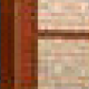
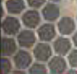




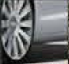
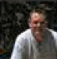

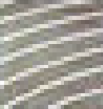
Why CNN for Image?
[Zeiler, M. D., ECCV 2014]
……
……
……
……
……
……
Represented as pixels
……
The most basic classifiers
Use 1st layer as module to build classifiers
Use 2nd layer as module ……
Can the network be simplified by considering the properties of images?

Slide 4


Why CNN for Image
Some patterns are much smaller than the whole image
A neuron does not have to see the whole image to discover the pattern.
Connecting to small region with less parameters
“beak” detector

Slide 5

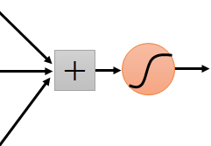
Why CNN for Image
The same patterns appear in different regions.
“upper-left beak” detector
Do almost the same thing
They can use the same set of parameters.
“middle beak” detector

Slide 6


Why CNN for Image
Subsampling the pixels will not change the object
bird
bird
subsampling
We can subsample the pixels to make image smaller
Less parameters for the network to process the image

Slide 7

The whole CNN
cat dog ……
Convolution
Max Pooling
Can repeat many times
Fully Connected Feedforward network
Convolution
Max Pooling
Flatten

Slide 8
The whole CNN
Property 1
Some patterns are much smaller than the whole image
Convolution
Property 2
Max Pooling
The same patterns appear in different regions.
Can repeat many times
Property 3
Convolution
Subsampling the pixels will not change the object
Max Pooling
Flatten

Slide 9
The whole CNN
cat dog ……
Convolution
Max Pooling
Can repeat many times
Fully Connected Feedforward network
Convolution
Max Pooling
Flatten

Slide 10
CNN – Convolution
Those are the network parameters to be learned.
1 | -1 | -1
-1 | 1 | -1
-1 | -1 | 1
1 | 0 | 0 | 0 | 0 | 1
0 | 1 | 0 | 0 | 1 | 0
0 | 0 | 1 | 1 | 0 | 0
1 | 0 | 0 | 0 | 1 | 0
0 | 1 | 0 | 0 | 1 | 0
0 | 0 | 1 | 0 | 1 | 0
Filter 1
Matrix
-1 | 1 | -1
-1 | 1 | -1
-1 | 1 | -1
Filter 2
Matrix
……
6 x 6 image
Each filter detects a small pattern (3 x 3).
Property 1

Slide 11
CNN – Convolution
1 | -1 | -1
-1 | 1 | -1
-1 | -1 | 1
Filter 1
stride=1
1 | 0 | 0 | 0 | 0 | 1
0 | 1 | 0 | 0 | 1 | 0
0 | 0 | 1 | 1 | 0 | 0
1 | 0 | 0 | 0 | 1 | 0
0 | 1 | 0 | 0 | 1 | 0
0 | 0 | 1 | 0 | 1 | 0
3
-1
6 x 6 image

Slide 12
CNN – Convolution
1 | -1 | -1
-1 | 1 | -1
-1 | -1 | 1
Filter 1
If stride=2
1 | 0 | 0 | 0 | 0 | 1
0 | 1 | 0 | 0 | 1 | 0
0 | 0 | 1 | 1 | 0 | 0
1 | 0 | 0 | 0 | 1 | 0
0 | 1 | 0 | 0 | 1 | 0
0 | 0 | 1 | 0 | 1 | 0
3
-3
We set stride=1 below
6 x 6 image

Slide 13
CNN – Convolution
1 | -1 | -1
-1 | 1 | -1
-1 | -1 | 1
Filter 1
stride=1
1 | 0 | 0 | 0 | 0 | 1
0 | 1 | 0 | 0 | 1 | 0
0 | 0 | 1 | 1 | 0 | 0
1 | 0 | 0 | 0 | 1 | 0
0 | 1 | 0 | 0 | 1 | 0
0 | 0 | 1 | 0 | 1 | 0
3
-1
-3
-1
-3
1
0
-3
-3
-3
0
1
3
-2
-2
-1
6 x 6 image
Property 2

Slide 14
CNN – Convolution
-1 | 1 | -1
-1 | 1 | -1
-1 | 1 | -1
Filter 2
stride=1
Do the same process for every filter
1 | 0 | 0 | 0 | 0 | 1
0 | 1 | 0 | 0 | 1 | 0
0 | 0 | 1 | 1 | 0 | 0
1 | 0 | 0 | 0 | 1 | 0
0 | 1 | 0 | 0 | 1 | 0
0 | 0 | 1 | 0 | 1 | 0
3
-1
-3
-1
-1
-1
-1
-1
-3
1
0
-3
-1
-1
-2
1
Feature
Map
-3
-3
0
1
-1
-1
-2
1
3
-2
-2
-1
6 x 6 image
-1
0
-4
3
4 x 4 image

Slide 15
CNN – Zero Padding
1 | -1 | -1
-1 | 1 | -1
-1 | -1 | 1
Filter 1
0
0
0
0
1 | 0 | 0 | 0 | 0 | 1
0 | 1 | 0 | 0 | 1 | 0
0 | 0 | 1 | 1 | 0 | 0
1 | 0 | 0 | 0 | 1 | 0
0 | 1 | 0 | 0 | 1 | 0
0 | 0 | 1 | 0 | 1 | 0
0
You will get another 6 x 6 images in this way
0
0
Zero padding
0
0
0
6 x 6 image

Slide 16
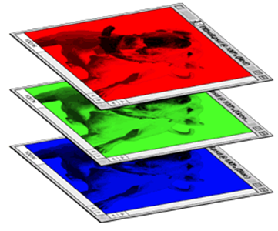
CNN – Colorful image
1 | -1 | -1
-1 | 1 | -1
-1 | -1 | 1
-1 | 1 | -1
-1 | 1 | -1
-1 | 1 | -1
1 | -1 | -1
-1 | 1 | -1
-1 | -1 | 1
-1 | 1 | -1
-1 | 1 | -1
-1 | 1 | -1
1 | -1 | -1
-1 | 1 | -1
-1 | -1 | 1
-1 | 1 | -1
-1 | 1 | -1
-1 | 1 | -1
Filter 1
Filter 2
Colorful image
1 | 0 | 0 | 0 | 0 | 1
0 | 1 | 0 | 0 | 1 | 0
0 | 0 | 1 | 1 | 0 | 0
1 | 0 | 0 | 0 | 1 | 0
0 | 1 | 0 | 0 | 1 | 0
0 | 0 | 1 | 0 | 1 | 0
1 | 0 | 0 | 0 | 0 | 1
0 | 1 | 0 | 0 | 1 | 0
0 | 0 | 1 | 1 | 0 | 0
1 | 0 | 0 | 0 | 1 | 0
0 | 1 | 0 | 0 | 1 | 0
0 | 0 | 1 | 0 | 1 | 0
1 | 0 | 0 | 0 | 0 | 1
0 | 1 | 0 | 0 | 1 | 0
0 | 0 | 1 | 1 | 0 | 0
1 | 0 | 0 | 0 | 1 | 0
0 | 1 | 0 | 0 | 1 | 0
0 | 0 | 1 | 0 | 1 | 0

Slide 17
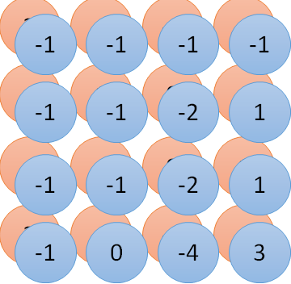
Convolution v.s. Fully Connected
1 | 0 | 0 | 0 | 0 | 1
0 | 1 | 0 | 0 | 1 | 0
0 | 0 | 1 | 1 | 0 | 0
1 | 0 | 0 | 0 | 1 | 0
0 | 1 | 0 | 0 | 1 | 0
0 | 0 | 1 | 0 | 1 | 0
1 | -1 | -1
-1 | 1 | -1
-1 | -1 | 1
-1 | 1 | -1
-1 | 1 | -1
-1 | 1 | -1
convolution
image
1 | 0 | 0 | 0 | 0 | 1
0 | 1 | 0 | 0 | 1 | 0
0 | 0 | 1 | 1 | 0 | 0
1 | 0 | 0 | 0 | 1 | 0
0 | 1 | 0 | 0 | 1 | 0
0 | 0 | 1 | 0 | 1 | 0
Fully-connected
……
……

Slide 18
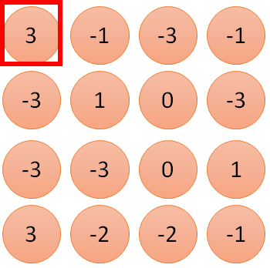
1 | -1 | -1
-1 | 1 | -1
-1 | -1 | 1
1:
1
Filter 1
2:
0
3:
0
3
4:
0
1 | 0 | 0 | 0 | 0 | 1
0 | 1 | 0 | 0 | 1 | 0
0 | 0 | 1 | 1 | 0 | 0
1 | 0 | 0 | 0 | 1 | 0
0 | 1 | 0 | 0 | 1 | 0
0 | 0 | 1 | 0 | 1 | 0
…
7:
0
8:
1
9:
0
10:
0
…
13:
0
6 x 6 image
14:
0
Less parameters!
15:
Only connect to 9 input, not fully connected
1
16:
1
…

Slide 19
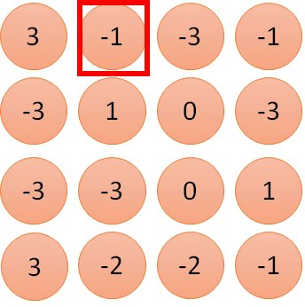
1 | -1 | -1
-1 | 1 | -1
-1 | -1 | 1
1:
1
Filter 1
2:
0
3:
0
3
4:
0
1 | 0 | 0 | 0 | 0 | 1
0 | 1 | 0 | 0 | 1 | 0
0 | 0 | 1 | 1 | 0 | 0
1 | 0 | 0 | 0 | 1 | 0
0 | 1 | 0 | 0 | 1 | 0
0 | 0 | 1 | 0 | 1 | 0
…
7:
0
8:
1
-1
9:
0
10:
0
…
13:
0
6 x 6 image
14:
0
Less parameters!
15:
1
16:
1
Shared weights
Even less parameters!
…

Slide 20
The whole CNN
cat dog ……
Convolution
Max Pooling
Can repeat many times
Fully Connected Feedforward network
Convolution
Max Pooling
Flatten

Slide 21
CNN – Max Pooling
1 | -1 | -1
-1 | 1 | -1
-1 | -1 | 1
-1 | 1 | -1
-1 | 1 | -1
-1 | 1 | -1
Filter 1
Filter 2
3
-1
-3
-1
-1
-1
-1
-1
-3
1
0
-3
-1
-1
-2
1
-3
-3
0
1
-1
-1
-2
1
3
-2
-2
-1
-1
0
-4
3

Slide 22
CNN – Max Pooling
New image
but smaller
1 | 0 | 0 | 0 | 0 | 1
0 | 1 | 0 | 0 | 1 | 0
0 | 0 | 1 | 1 | 0 | 0
1 | 0 | 0 | 0 | 1 | 0
0 | 1 | 0 | 0 | 1 | 0
0 | 0 | 1 | 0 | 1 | 0
Conv
3
0
-1
1
Max
Pooling
3
1
0
3
2 x 2 image
6 x 6 image
Each filter
is a channel

Slide 23
The whole CNN
3
0
-1
1
Convolution
3
1
0
3
Max Pooling
Can repeat many times
A new image
Convolution
Smaller than the original image
The number of the channel is the number of filters
Max Pooling

Slide 24
The whole CNN
cat dog ……
Convolution
Max Pooling
A new image
Fully Connected Feedforward network
Convolution
Max Pooling
A new image
Flatten

Slide 25
Flatten
3
0
1
3
0
-1
1
3
3
1
-1
0
3
Flatten
1
Fully Connected Feedforward network
0
3

Slide 26
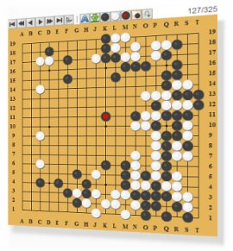
More Application: Playing Go
Network
Next move
(19 x 19 positions)
19 x 19 matrix (image)
19 x 19 vector
19 x 19 vector
Fully-connected feedforward network can be used
Black: 1
white: -1
none: 0
But CNN performs much better.

Slide 27
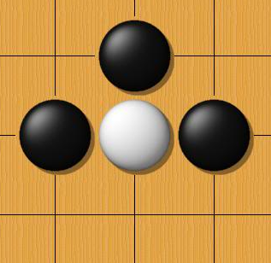
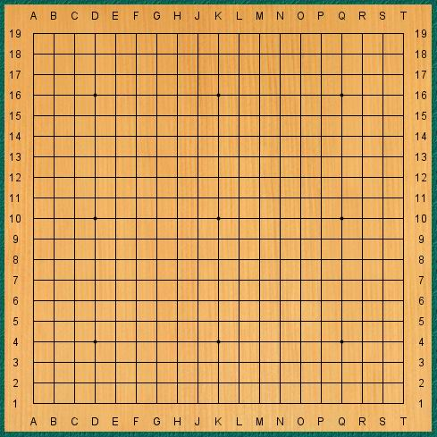
Why CNN for playing Go?
Some patterns are much smaller than the whole image
The same patterns appear in different regions.
Alpha Go uses 5 x 5 for first layer

Slide 28
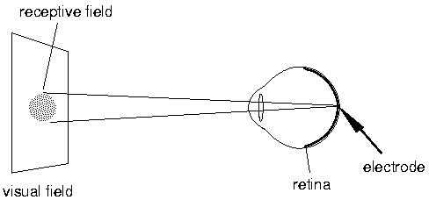
A Brief History of CNN
每只人类的眼睛有10⁸个视觉接收器（比如视锥，视杆等等），但是我们只有10⁶个视觉神经。因此，可知每一个视觉神经都接收来自多个视觉接受细胞的输入。
视觉神经不是简单的告诉大脑光线被检测到，而是感受光线和黑暗之间的对比，也就是形状被感受到了。
我们的每个单个神经元并不会对整个图像做出回应，而是只对其负责的receptive filed响应。

Slide 29
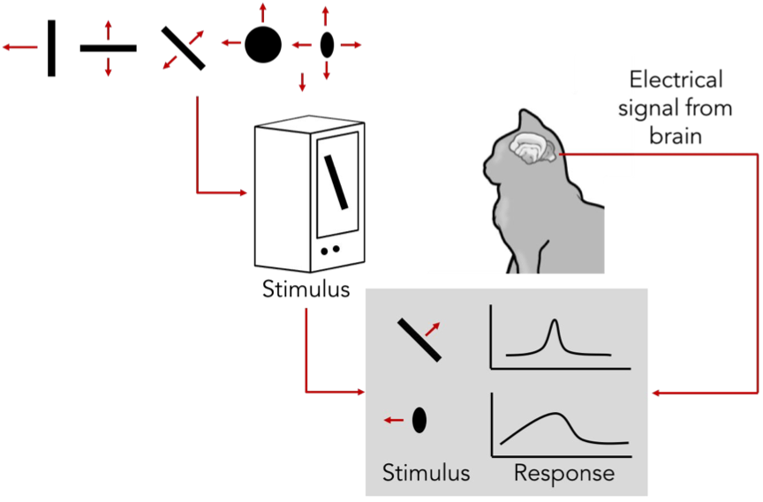
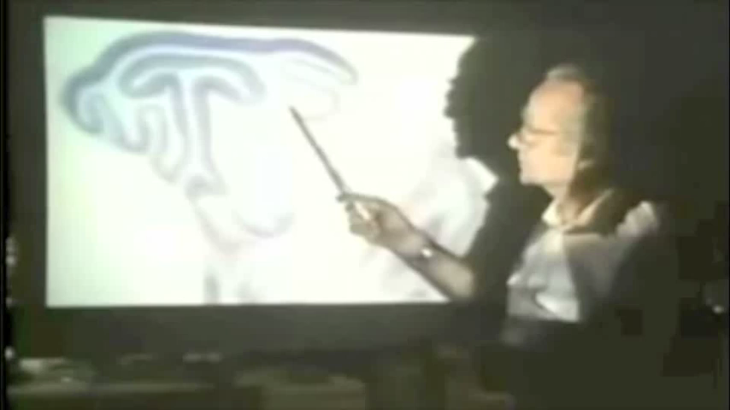
A Brief History of CNN
Hubel & Wiesel (1981年诺贝尔奖)
1959
RECEPTIVE FIELDS OF SINGLE NEURONES IN THE CAT’S STRIATE CORTEX
1962
RECEPTIVE FIELDS, BINOCULAR INTERACTION AND FUNCTIONAL ARCHITECTURE IN THE CAT’S VISUAL CORTEX
1968...

Slide 30
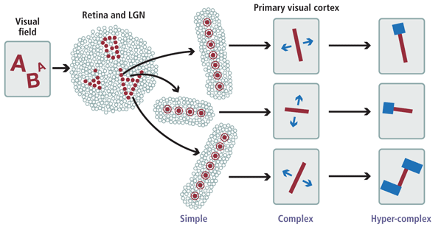
A Brief History of CNN
Hierarchical organization
Simple cells: response to light orientation
Complex cells: response to light orientation and movement
Hypercomplex cells: response to movement with an endpoint
LGN会响应一个微小的光点，但是对漫反射没什么回应
不再响应光点，但是对亮暗的线条有响应
不再对区域敏感
对端点敏感

Slide 31
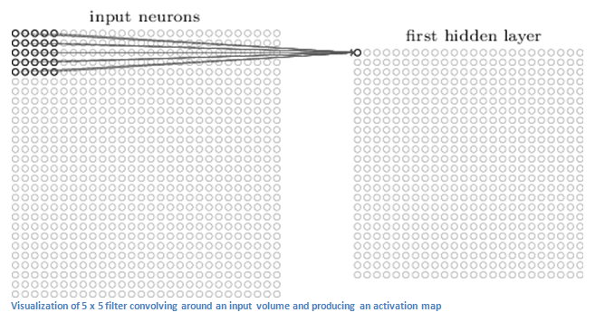
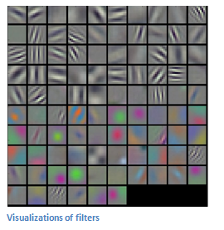
A Brief History of CNN
Local connection
Translation invariance
Filtering

Slide 32
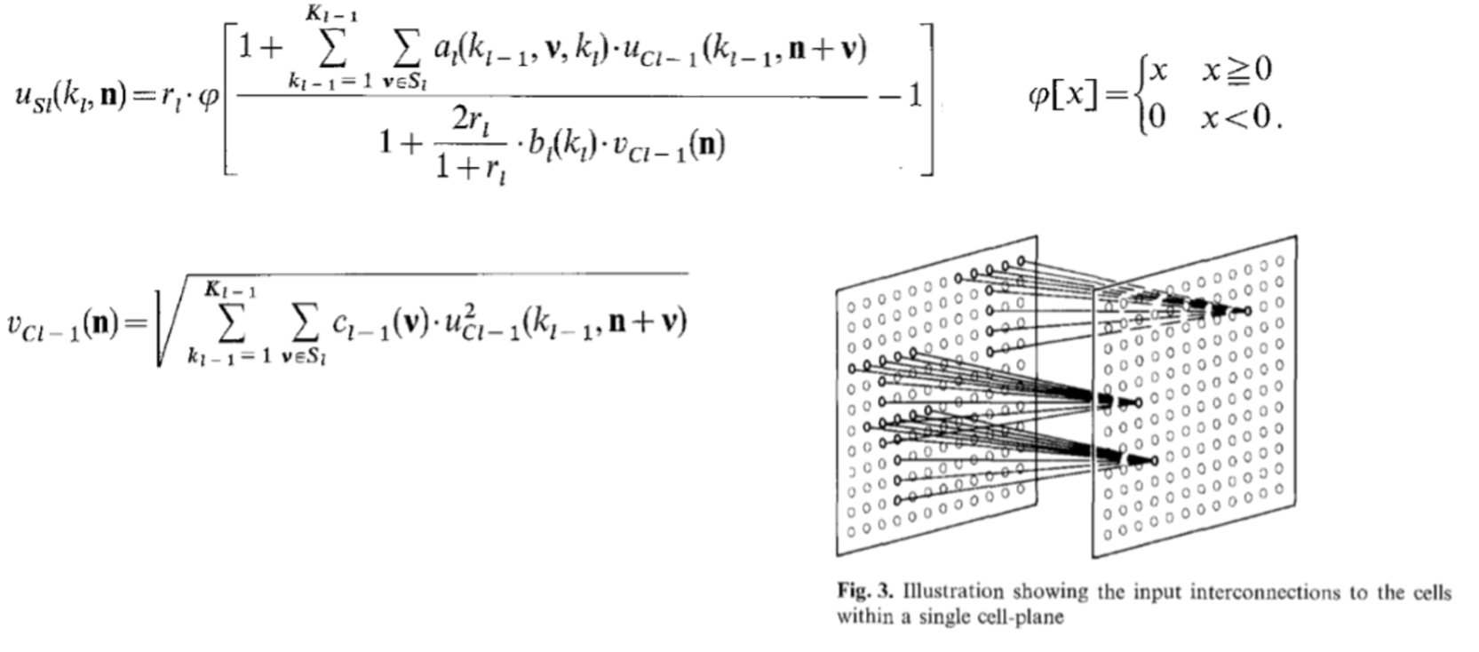
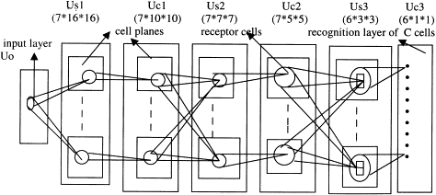
A Brief History of CNN
Neocognitron [Kunihiko Fukushima, 1980]
将脑神经科学的结构在做了计算机模拟
提出了现在CNN常用的step-by-step的filter
使用ReLU来给网络提供非线性
采用平均池化来做downsampling
保证了网络的平移不变性
实现了稀疏交互

Slide 33
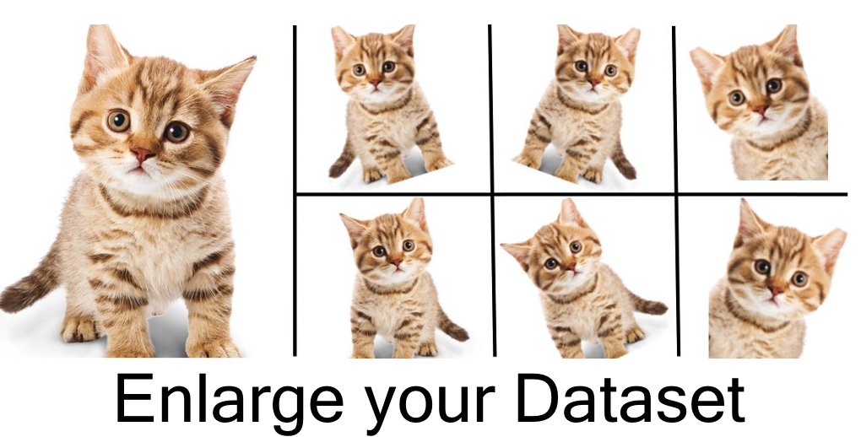
A Brief History of CNN
BP for CNN 1990 [LeCun et al. ]
提出了权值共享，这个操作减少了自由变量的数量，也就减少了过拟合的风险，提高了泛化能力。参数的减少同时也加速了训练过程。
Cresceptron 1992 [Weng et al. ]
Data Augmentation
最大池化

Slide 34
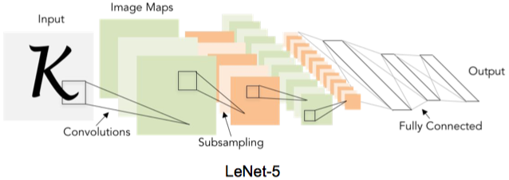
A Brief History of CNN
Gradient-based learning applied to document recognition [LeCun, Bottou, Bengio, Haffner 1998]
使用了tanh作为激活函数

Slide 35
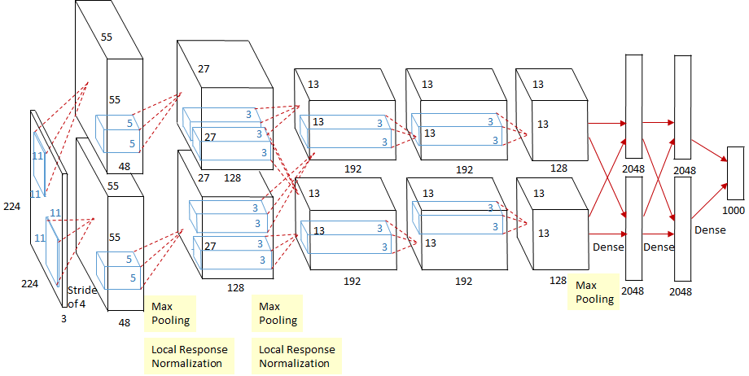
A Brief History of CNN
AlexNet: ImageNet Classification with Deep Convolutional Neural Networks [Krizhevsky, Sutskever, Hinton, 2012]

Slide 36

Today: CNN are everywhere!
Self-driving

Slide 37
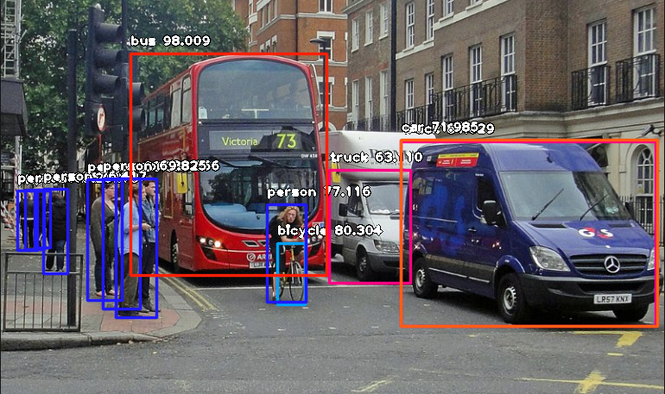
Today: CNN are everywhere!
Object Detection

Slide 38
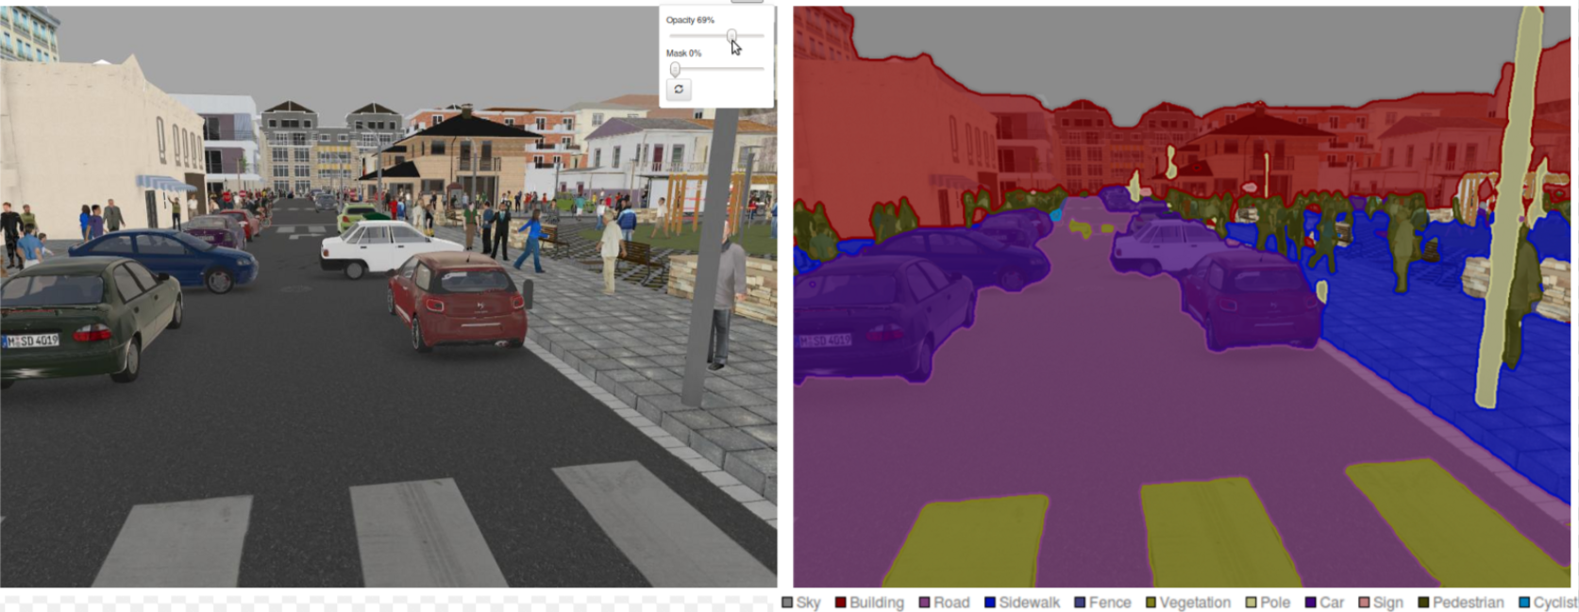
Today: CNN are everywhere!
Segmentation

Slide 39
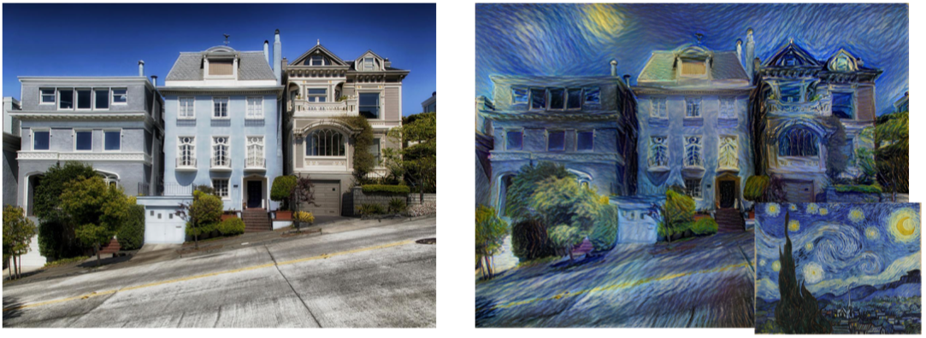
Today: CNN are everywhere!
Image Style Transfer

Slide 40
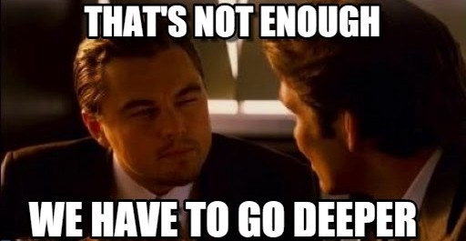
CNN Variants

Slide 41
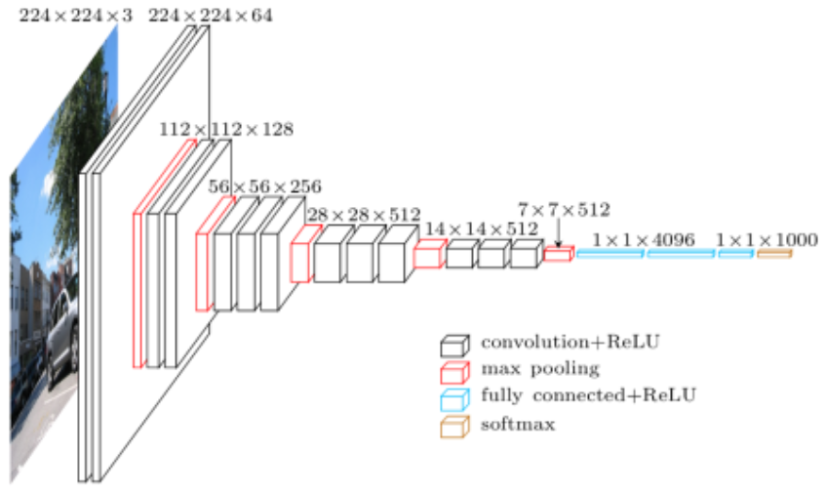
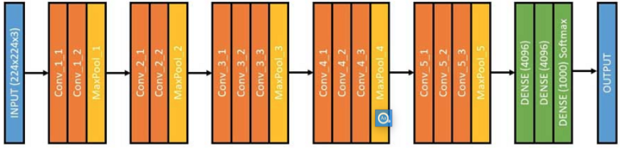
CNN Variants: VGGNet
VGGNet [Simonyan and Zisserman, 2014]]
Because of the simplicity of it’s uniform architecture, it appeals to a new-comer as a simpler form of a deep convolutional neural network.

Slide 42
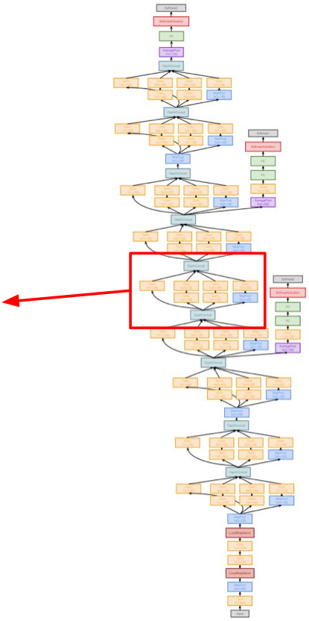
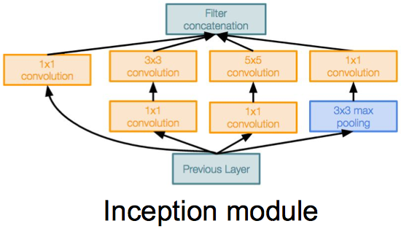
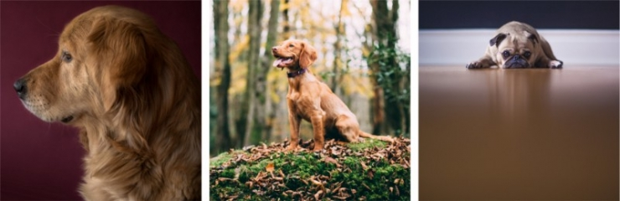
CNN Variants: GoogLeNet (Inception)
GoogLeNet [Szegedy et al., 2014]
It used an inception module, a novel concept, with smaller convolutions that allowed the reduction of number of parameters to a mere 4 million.

Slide 43
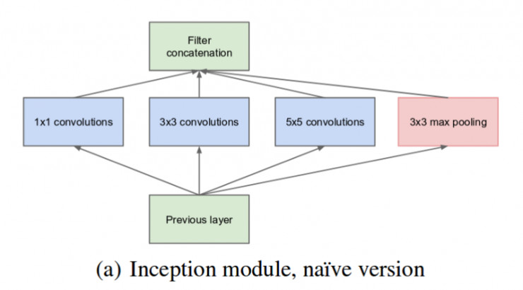
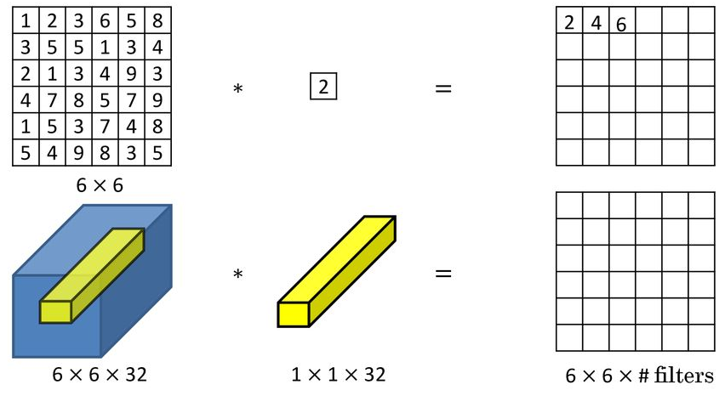
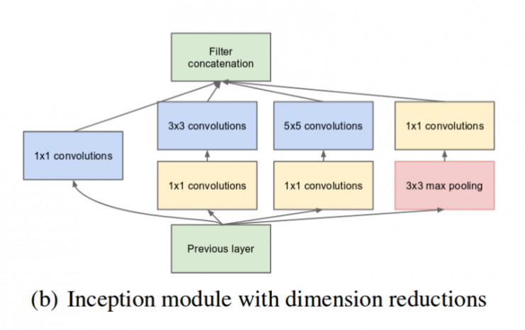
CNN Variants: GoogLeNet (Inception)

Slide 44
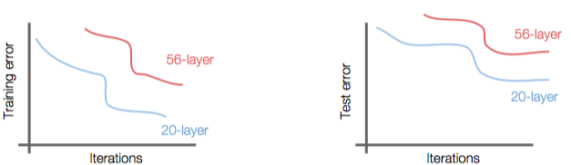
CNN Variants: ResNet
ResNet [He et al., 2015]
What happens when we continue stacking deeper layers on a “plain” convolutional neural network?
56-layer model performs worse on both training and test error -> The deeper model performs worse, but it’s not caused by overfitting!

Slide 45
CNN Variants: ResNet
Hypothesis: the problem is an optimization problem, deeper models are harder to optimize
The deeper model should be able to perform at least as well as the shallower model.
A solution by construction is copying the learned layers from the shallower model and setting additional layers to identity mapping.

Slide 46
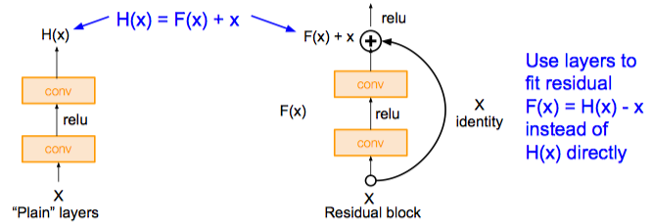
CNN Variants: ResNet
ResNet [He et al., 2015]
Direct mappings are hard to learn. So instead of learning mapping between output of layer and its input, learn the difference between them — learn the residual.

Slide 47
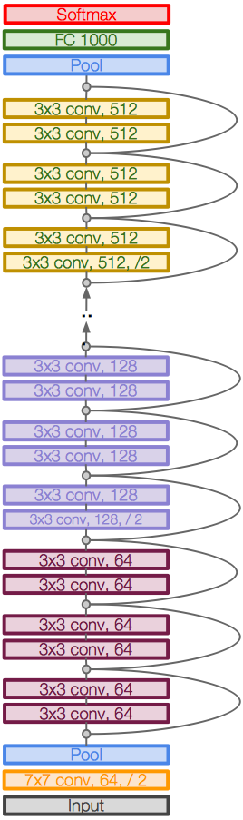
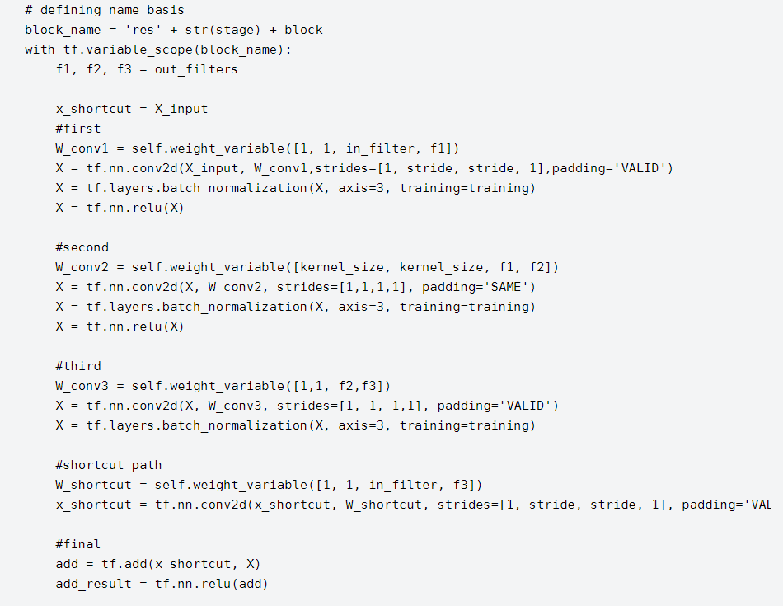
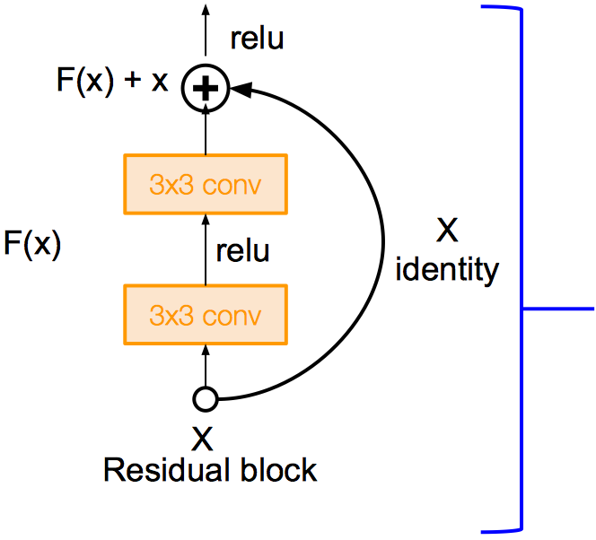
CNN Variants: ResNet
ResNet [He et al., 2015]
Skip connection can be implemented as two lines of code :
# Store the initial value of X in a variable
## Perform convolution + batch norm operations on X
# SKIP Connection

Slide 48
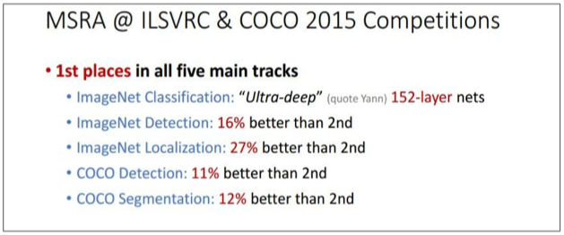
CNN Variants: ResNet
Experimental Results :
Able to train very deep networks without degrading (152 layers on ImageNet, 1202 on Cifar)
Deeper networks now achieve lowing training error as expected
Swept 1st place in all ILSVRC and COCO 2015 competitions

Slide 49
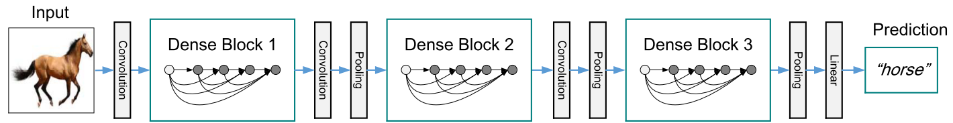
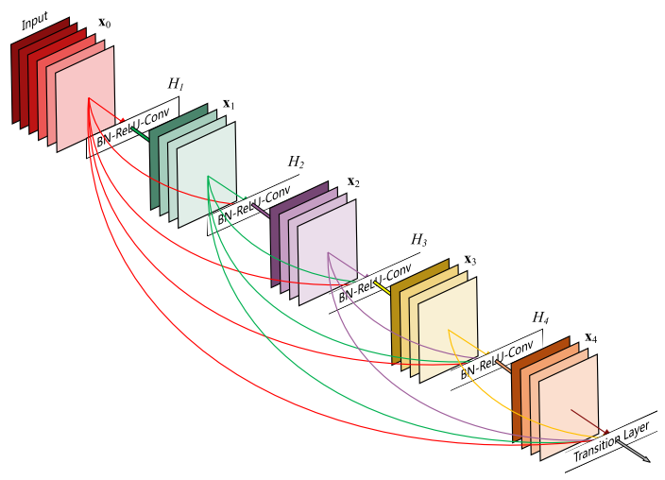
CNN Variants: DenseNet

Slide 50
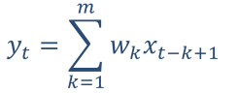
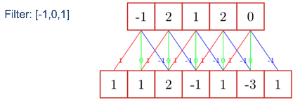

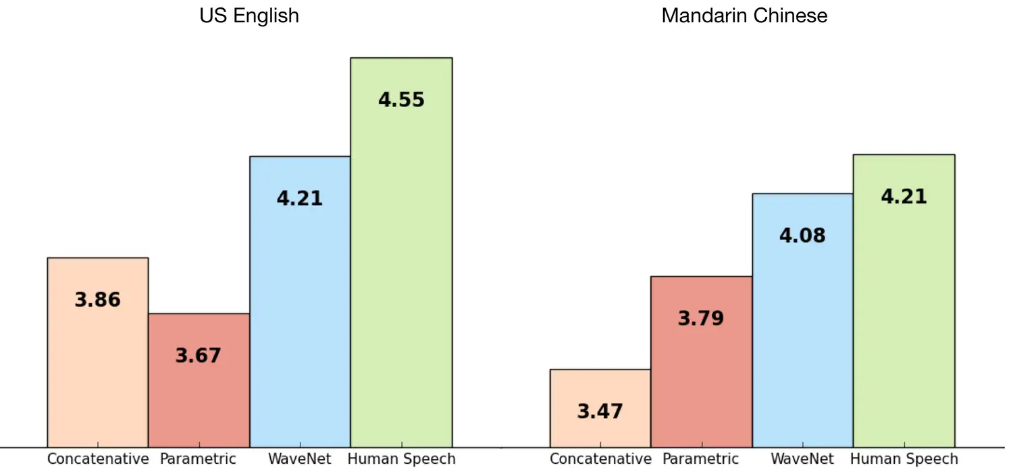

1D Convolution
1D discrete convolution generally:
concatenative
wavenet

Slide 51
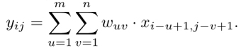
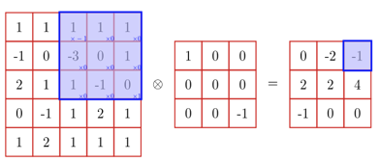
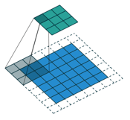

2D Convolution
2D convolution generally:

Slide 52

2D Convolution with 3D input

Slide 53




3D Convolution

Slide 54


Graph Convolution
Learning Convolutional Neural Networks for Graphs ——ICML 2016

Slide 55

Spherical Convolution
DEEP LEARNING 3D SHAPES USING ALT-AZANISOTROPIC 2-SPHERE CONVOLUTION [ICLR 2019]

Slide 56




DeConv (转置卷积)

Slide 57



What is wrong with CNNs
Geoffrey Hinton talk "What is wrong with convolutional neural nets ?"
https://www.youtube.com/watch?v=rTawFwUvnLE

Slide 58




What is wrong with CNNs
The pooling operation used in convolutional neural networks is a big mistake and the fact that it works so well is a disaster --Hinton
Computer graphics takes internal representation of objects and produces an image (rendering, i.e., inverse graphics). Human brain does the opposite.

Slide 59


Capsule Network
Hinton: "Does the Brain do Inverse Graphics?" [1]
Capsule Network [2]
key idea is that representation of objects in the brain does not depend on view angle.
https://www.youtube.com/watch?v=TFIMqt0yT2I
Sabour, Sara, Nicholas Frosst, and Geoffrey E. Hinton. "Dynamic routing between capsules." NIPS. 2017.

Slide 60

Capsule Network

Slide 61


Capsule Network
dynamic routing

Slide 62
CNN for NLP

Slide 63

Sentence Classification
Bag of Words (BOW)

Slide 64

Bag of n-grams

Slide 65

Why Bag of n-grams?
Allow us to capture combination features in a simple way “don’t love”, “not the best”
Works pretty well
Problems
Same as before: parameter explosion
No sharing between similar words/n-grams

Slide 66

CNN for NLP (Striding)

Slide 67
CNN for NLP (Pooling)
Max pooling: “Did you see this feature anywhere in the range?” (most common)
Average pooling: “How prevalent is this feature over the entire range”
k-Max pooling: “Did you see this feature up to k times?”
Dynamic pooling: “Did you see this feature in the beginning? In the middle? In the end?”

Slide 68

CNN for NLP

Slide 69

Stacked Convolution
Feeding in convolution from previous layer results in larger area of focus for each feature

Slide 70



Dilated Convolution
Gradually increase stride: low-level to high-level [Kalchbrenner et al. 2016]

Slide 71
Dilated Convolution
In contrast to recurrent neural networks (next class)
+ Fewer steps from each word to the final representation: RNN O(N), Dilated CNN O(log N)
+ Easier to parallelize on GPU
- Slightly less natural for arbitrary-length dependencies
- A bit slower on CPU?

Slide 72

Structured Convolution
Why Structured Convolution?
Language has structure, would like it to localize features
e.g. noun-verb pairs very informative, but not captured by normal CNNs
Example: Dependency Structure

Slide 73

Tree-structured Convolution
Convolve over parents, grandparents, siblings
Ma et al. 2015

Slide 74

Graph Convolution
Convolution is shaped by graph structure
For example, dependency tree is a graph with
Self-loop connections
Dependency connections
Reverse connections
Marcheggiani et al. 2017

Slide 75
Any Questions?

